Slide 1
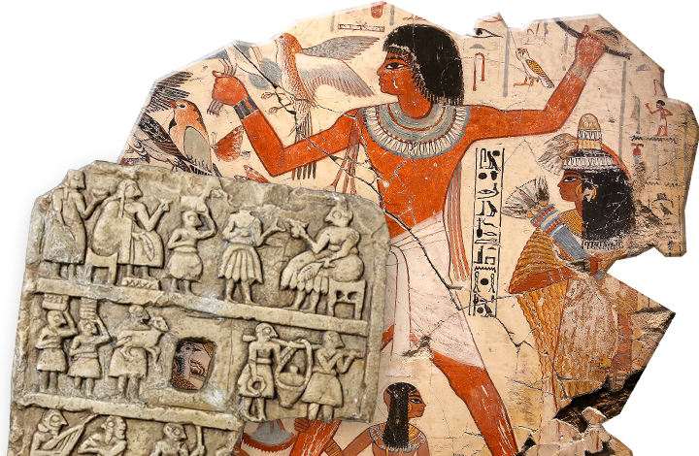
Task 4 Investigating Ancient Civilisations
Goal/s:
Discuss the requirements and expectations of task 4
Week 11 Lesson 1
Ms Barrie

Slide 2
Project Overview
Task Booklet

Slide 3
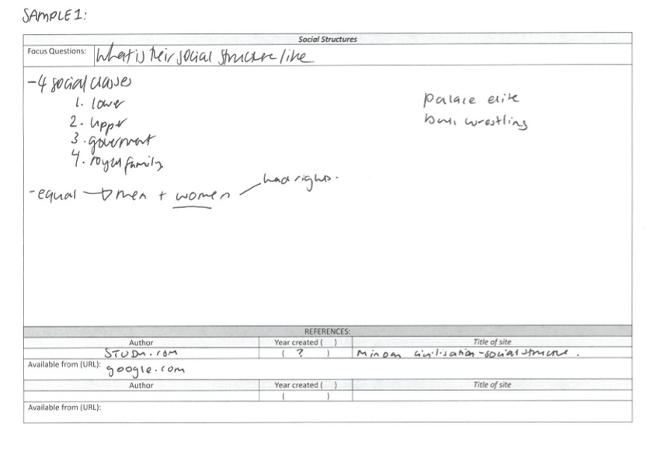
Sample 1

Slide 4
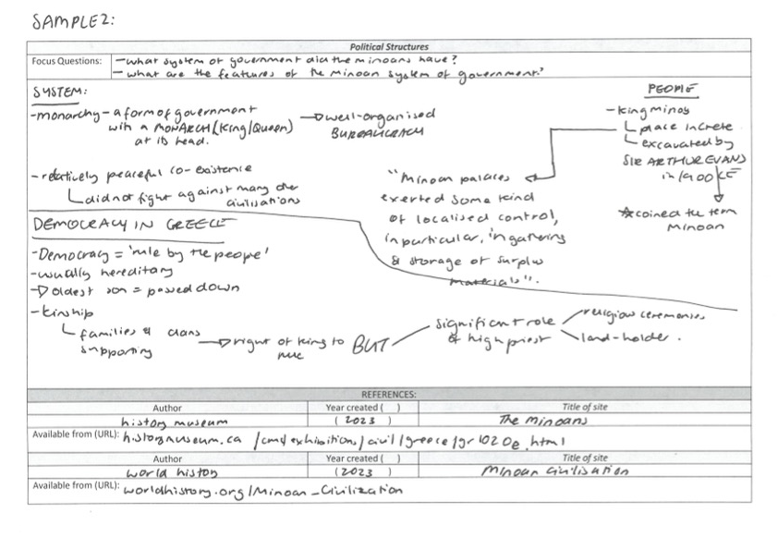
Sample 2

Slide 5
Project Timeline – Task 4
 | Tuesday | Wednesday | Thursday | Friday
Week 1 | NO CLASS | Intro to task Focus Questions | Research Booklet TOPIC 1 | Research Booklet TOPIC 2
Week 2 | Research Booklet TOPIC 3 | Research Booklet TOPIC 4 | Research Booklet TOPIC 5 | Research Booklet TOPIC 6
Week 3 | Research Booklet TOPIC 7 | Research Booklet TOPIC 8/Final Research Lesson | Presentation Creation | Presentation Creation
Week 4 | Presentation Creation | Presentation Creation | Presentation Creation | EVERYTHING DUE

Slide 6
What to do and what NOT to do
Use a variety of formats
Use dot-points and simple information
Think carefully
Aim for well above standard
Record all websites
ASK FOR HELP IF YOU NEED IT
Write in full sentences
Leave the page half-blank
Use the google home page
Forget to record websites
Copy someone else’s work

Slide 7

Today’s Lesson
Create your focus questions
Begin Research

Slide 8
Thursday – Topic 1
key social structures of the ancient civilisation, for example:
the main social hierarchies, for example, elites, workers, slaves, ethnic groups and foreigners
role and status of women
role and treatment of children

Slide 9
Friday – Topic 2
key political structures of the ancient civilisation, for example:
political organisation, for example, monarchy, tyranny, aristocracy/oligarchy, republic ♣ legal structures

Slide 10
Tuesday – Topic 3
key military structures of the ancient civilisation, for example:
military organisation, weaponry, tactics
role and function of the military

Slide 11
Wednesday – Topic 4
key economic activities, for example:
agriculture, trade, commerce, industry

Slide 12
Thursday – Topic 5
key values, beliefs and traditions characteristic of the ancient civilisation, for example:
origin stories, religious beliefs, funerary customs, mythology

Slide 13
Friday – Topic 6
key features of the culture of the ancient civilisation, for example:
art, music, architecture

Slide 14
Tuesday – Topic 7
key events and developments of the civilisation

Slide 15
Wednesday – Topic 8
key people of the ancient civilisation, including leaders and/or mythic figures

